Slide 1
Blockchain Project
Fall 2024
Github link: https://github.com/SahithiV7/Blockchain_Project
Naga Sahithi Vunnam-16355633

Slide 2
Project Title
Crowdfunding DApp
A Decentralized Solution for Transparent Fundraising

Slide 3
Objective
To develop a decentralized crowdfunding platform using blockchain technology, enabling secure, transparent, and milestone-based fund release. The platform eliminates intermediaries, reduces costs, and provides backers with a trustworthy way to support projects while ensuring creators receive funds fairly.

Slide 4
Challenges in Traditional Crowdfunding
=> Issues:
lack of transparency
high fees, and
limited trust.

Slide 5
How Our App Solves These Issues
Decentralized funding powered by Ethereum blockchain.
Transparent smart contracts for milestone-based fund release.
Secure wallet integration using MetaMask.

Slide 6
Features of the Crowdfunding App
Decentralized and secure crowdfunding.
Smart contract-enforced fund release based on milestones.
Seamless MetaMask wallet integration.
User-friendly React-based interface

Slide 7
Technology Stack
Tools and frameworks:
Solidity for Smart Contracts.
Truffle and Ganache for testing and development.
React for the frontend.
MetaMask for wallet management.

Slide 8
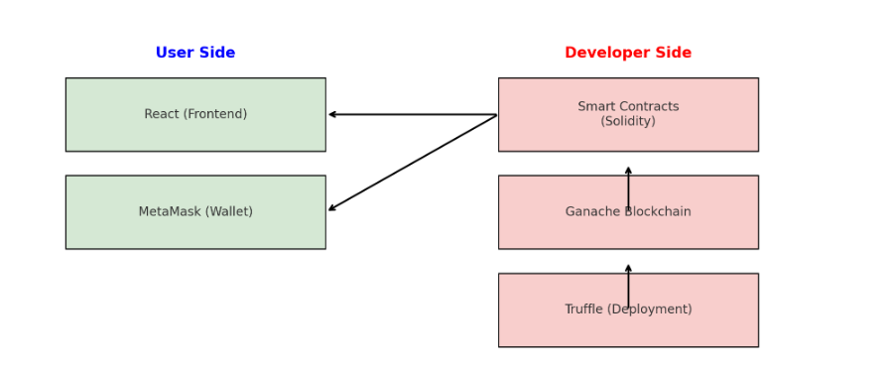
System Architecture
User Interface (React).
Blockchain (Smart Contracts on Ethereum).
Ganache (Local Ethereum Network).

Slide 9
Installation and Setup
Key Steps:
Prerequisites: Node.js, Truffle, Ganache, MetaMask.
Installation commands for dependencies and project setup.
Running the local blockchain and migrating contracts.

Slide 10
Workflow
Step-by-step process:
Creating a campaign.
Contributing to campaigns(Funding).
Releasing funds.

Slide 11
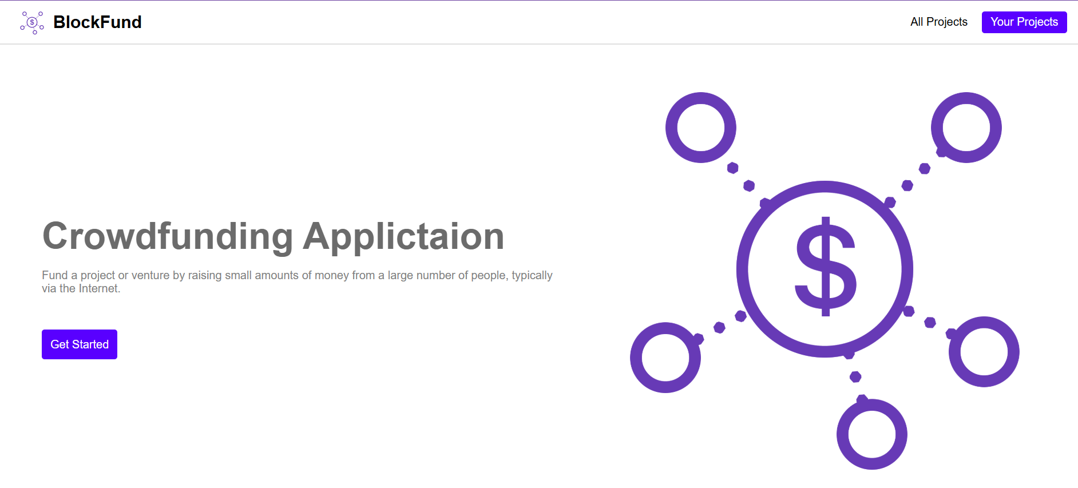
Results

Slide 12
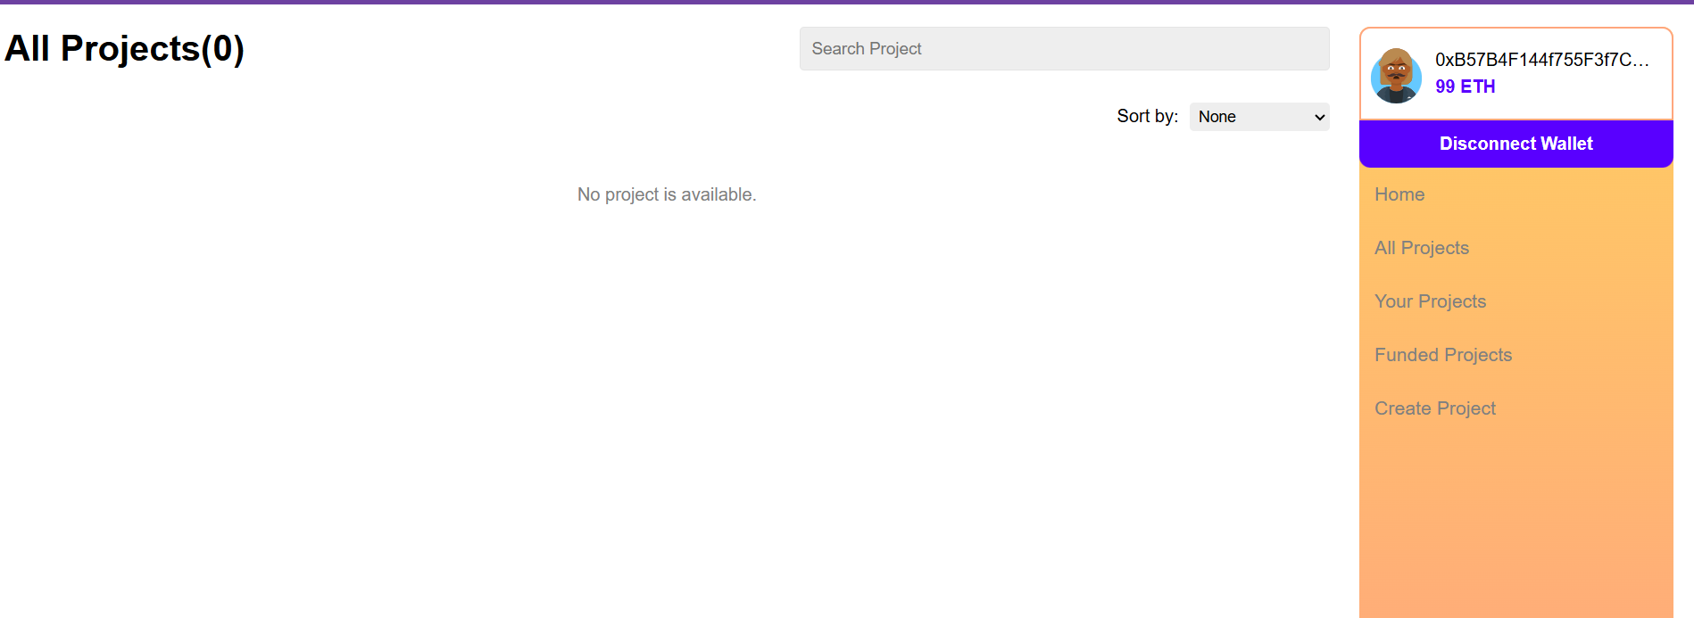
Interface of my DApp

Slide 13
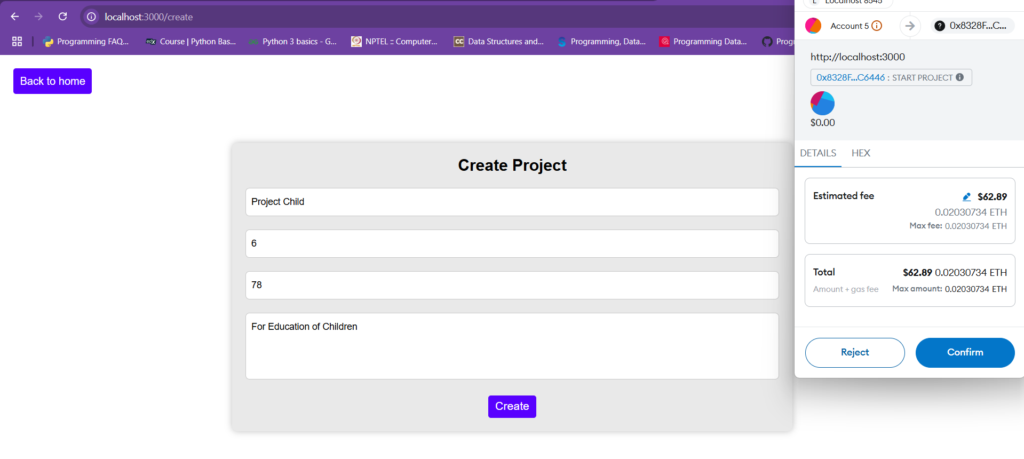
Creating a Project

Slide 14
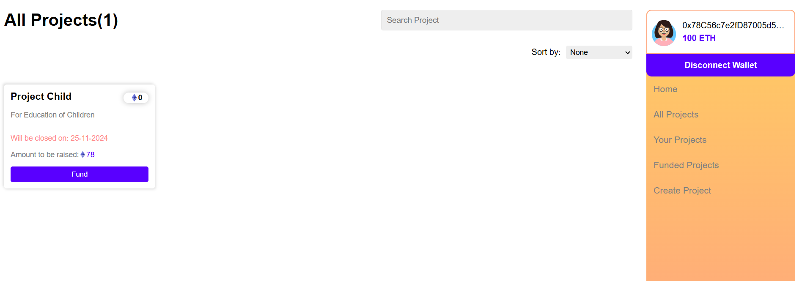

Slide 15
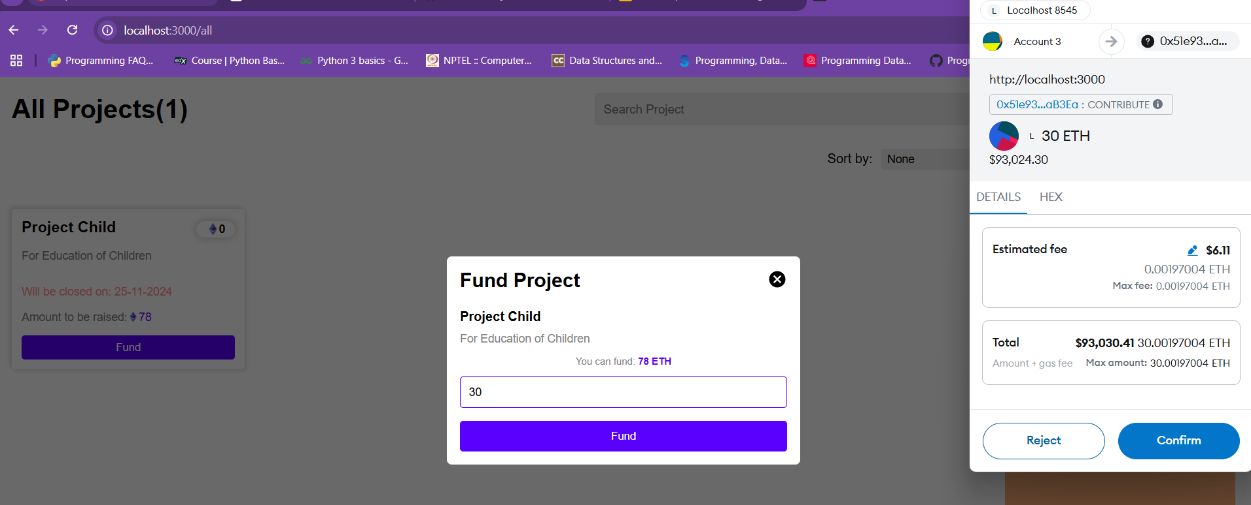
Funding the Project from user 2

Slide 16
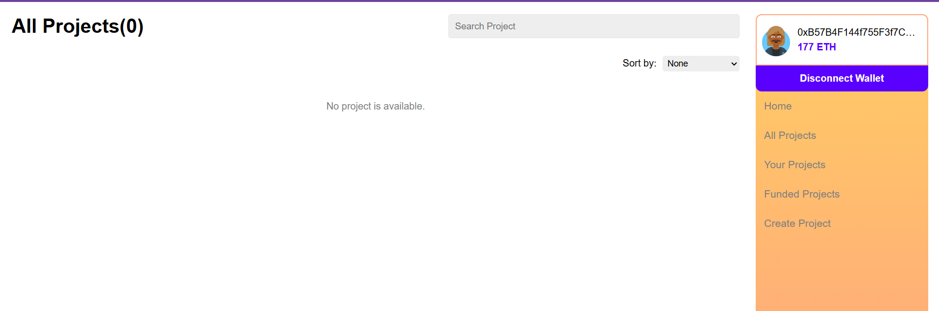
Funds reached the user 1 account

Slide 17
Challenges Faced
Setting up the local blockchain environment.
Smart contract debugging and gas optimization.
Ensuring seamless MetaMask integration.

Slide 18
What’s Next?
Multi-currency support.
Integration with other blockchain networks.
Advanced analytics for campaign tracking.

Slide 19
In Summary
Blockchain ensures security and transparency.
Smart contracts enforce fairness in crowdfunding.
The app provides a decentralized and user-friendly experience.

Slide 20
Any Questions?

Slide 21
Thank you

